Slide 1
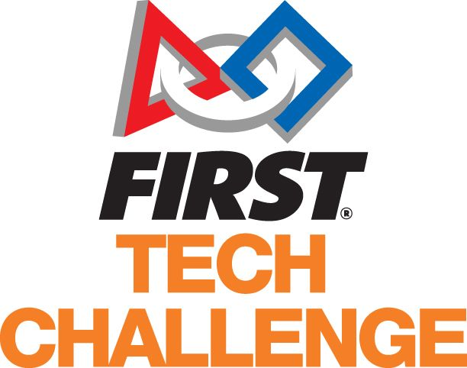
THEMANDELBOTS TEAM: 12063

Slide 2
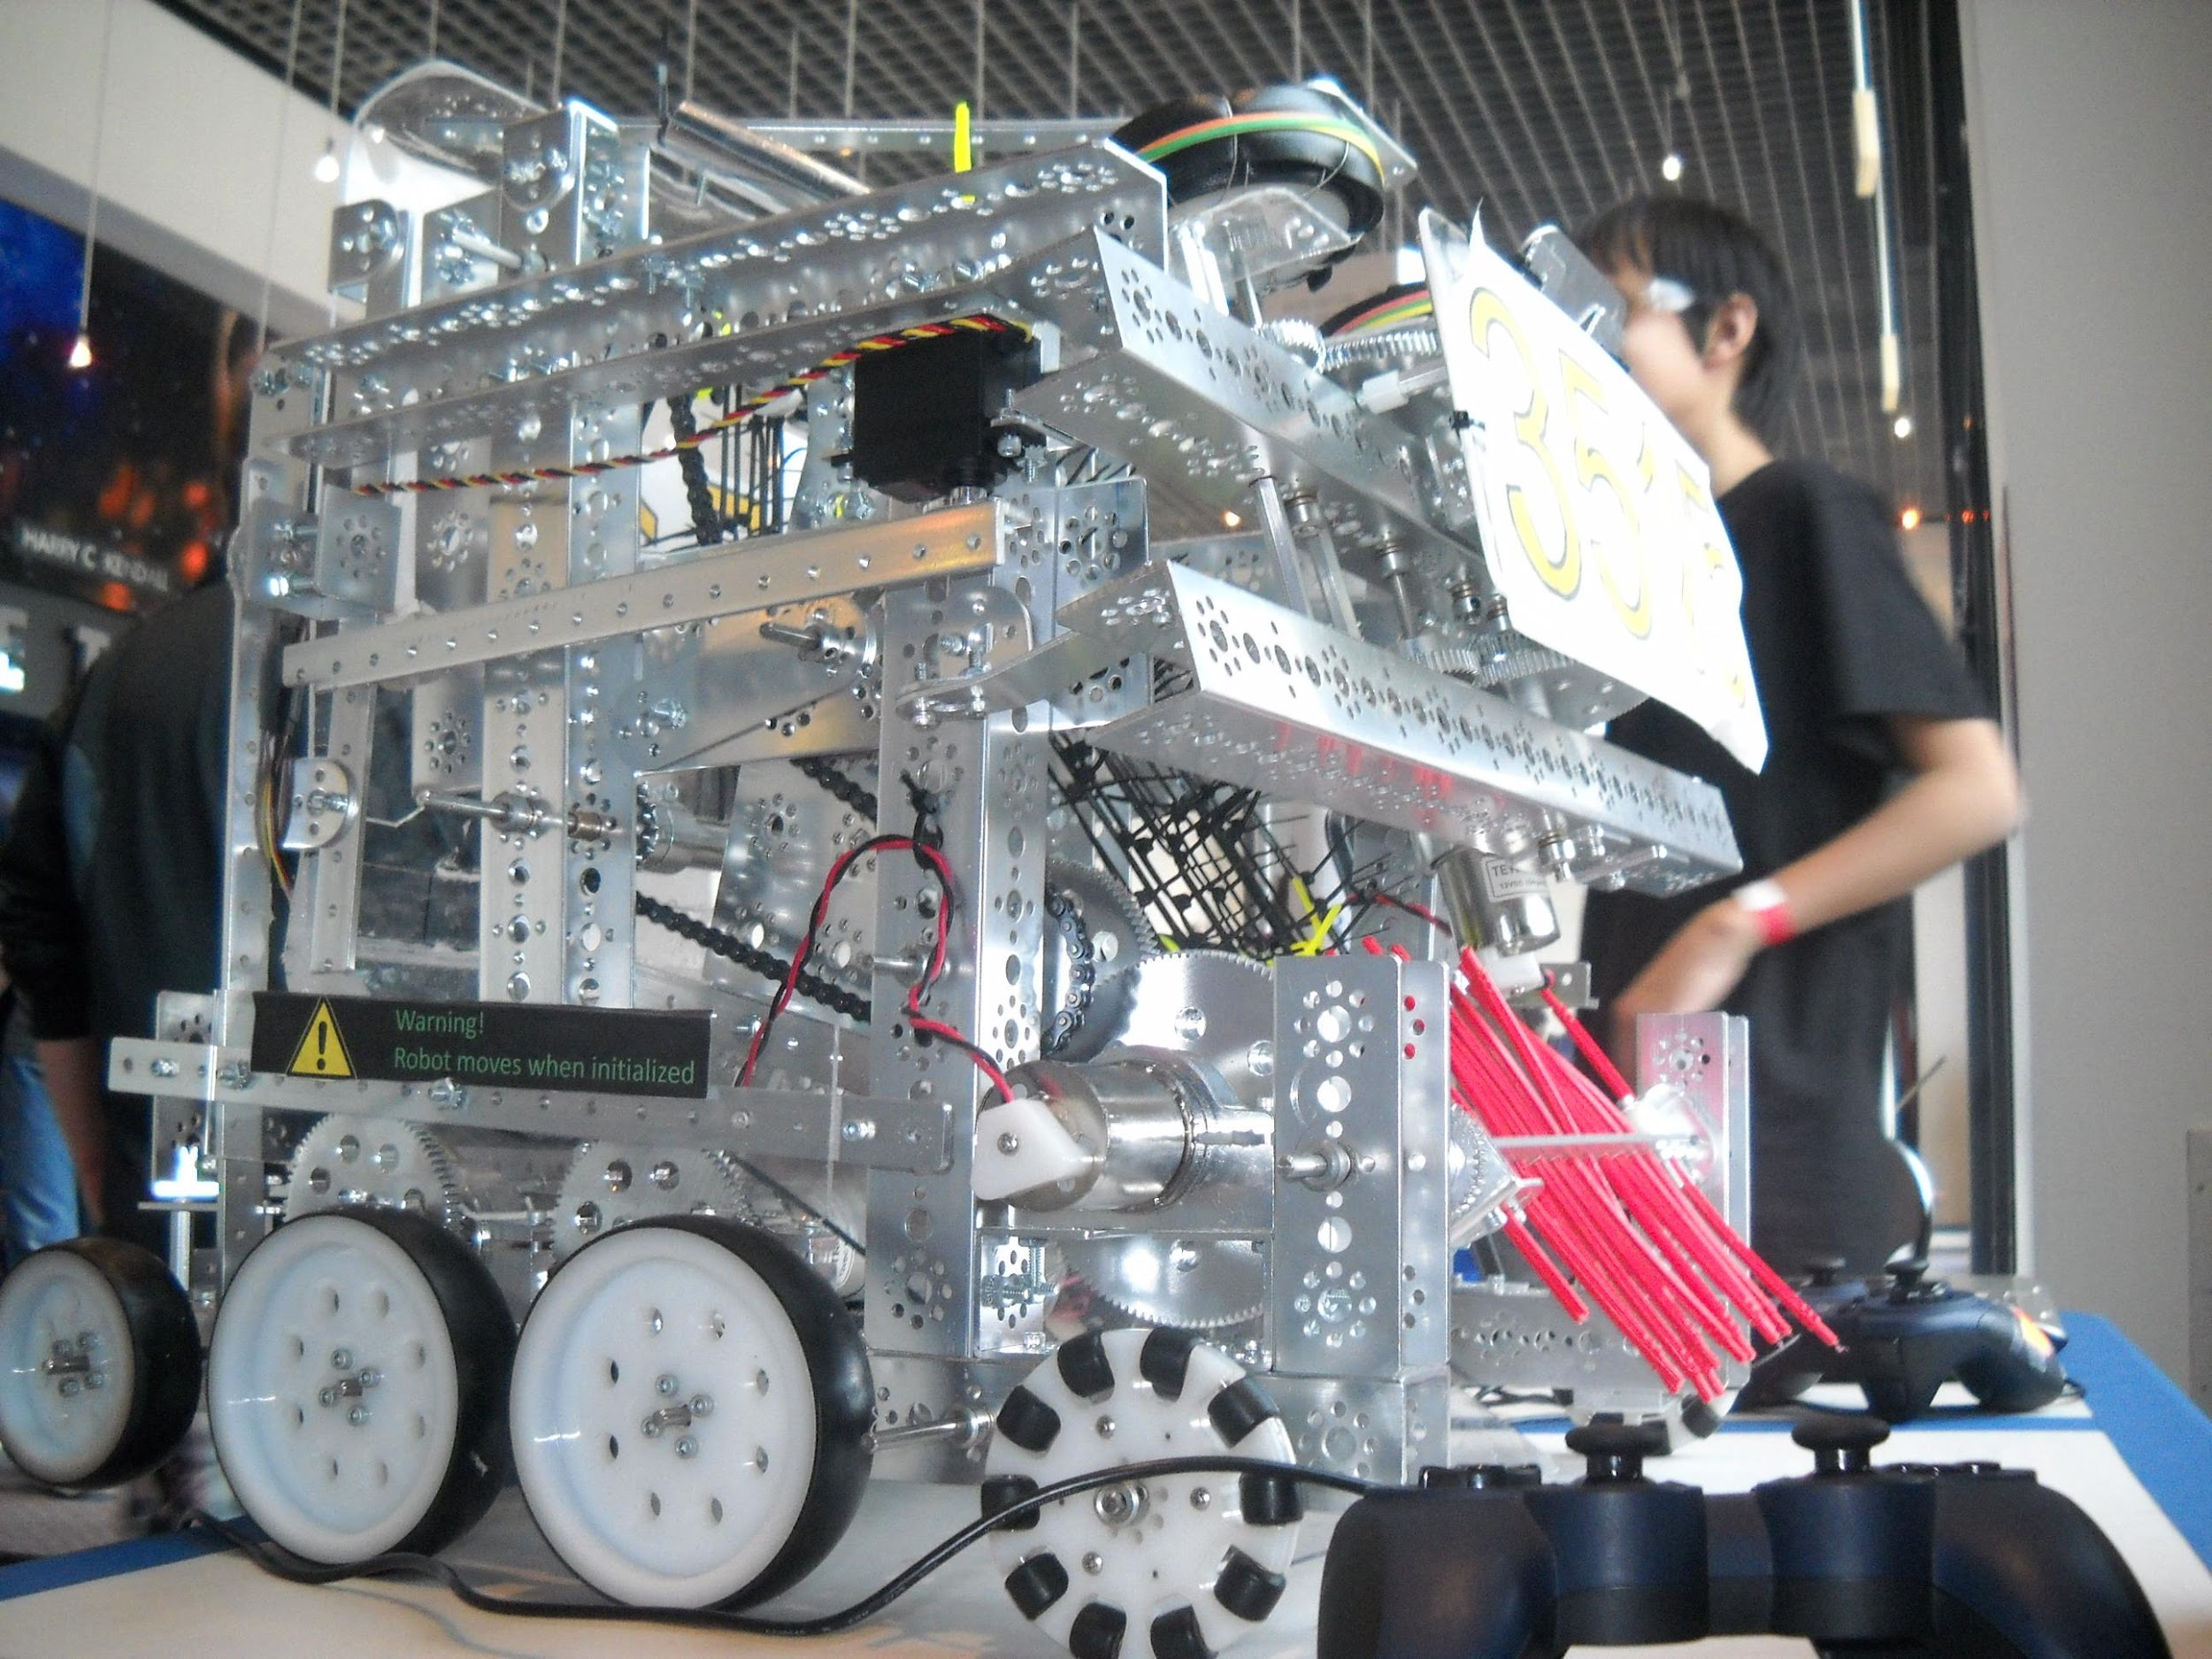
What is the first tech challenge (FTC)
The First Tech challenge is a robotics based competition where participants design, build, program, and operate robots. These robots are then put to the test against a field containing various obstacles and objectives, which the completion of such are scored. Teams create solutions through the design process and team work and are pushed to innovate and invent.
The First tech challenge encourages teams to get out and be valuable parts of society with the community outreach aspect of the challenge.

Slide 3
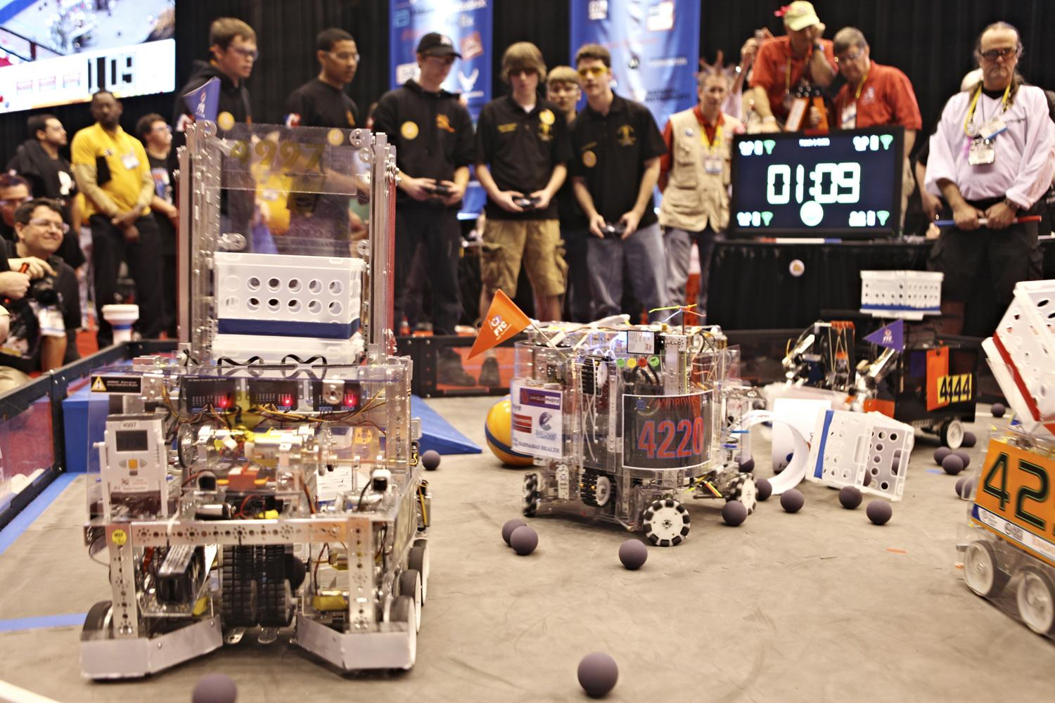
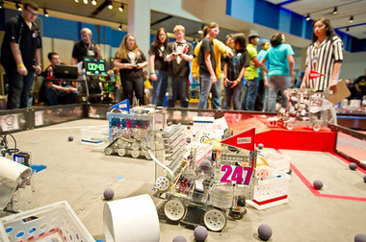
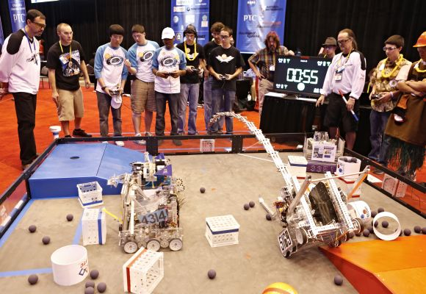
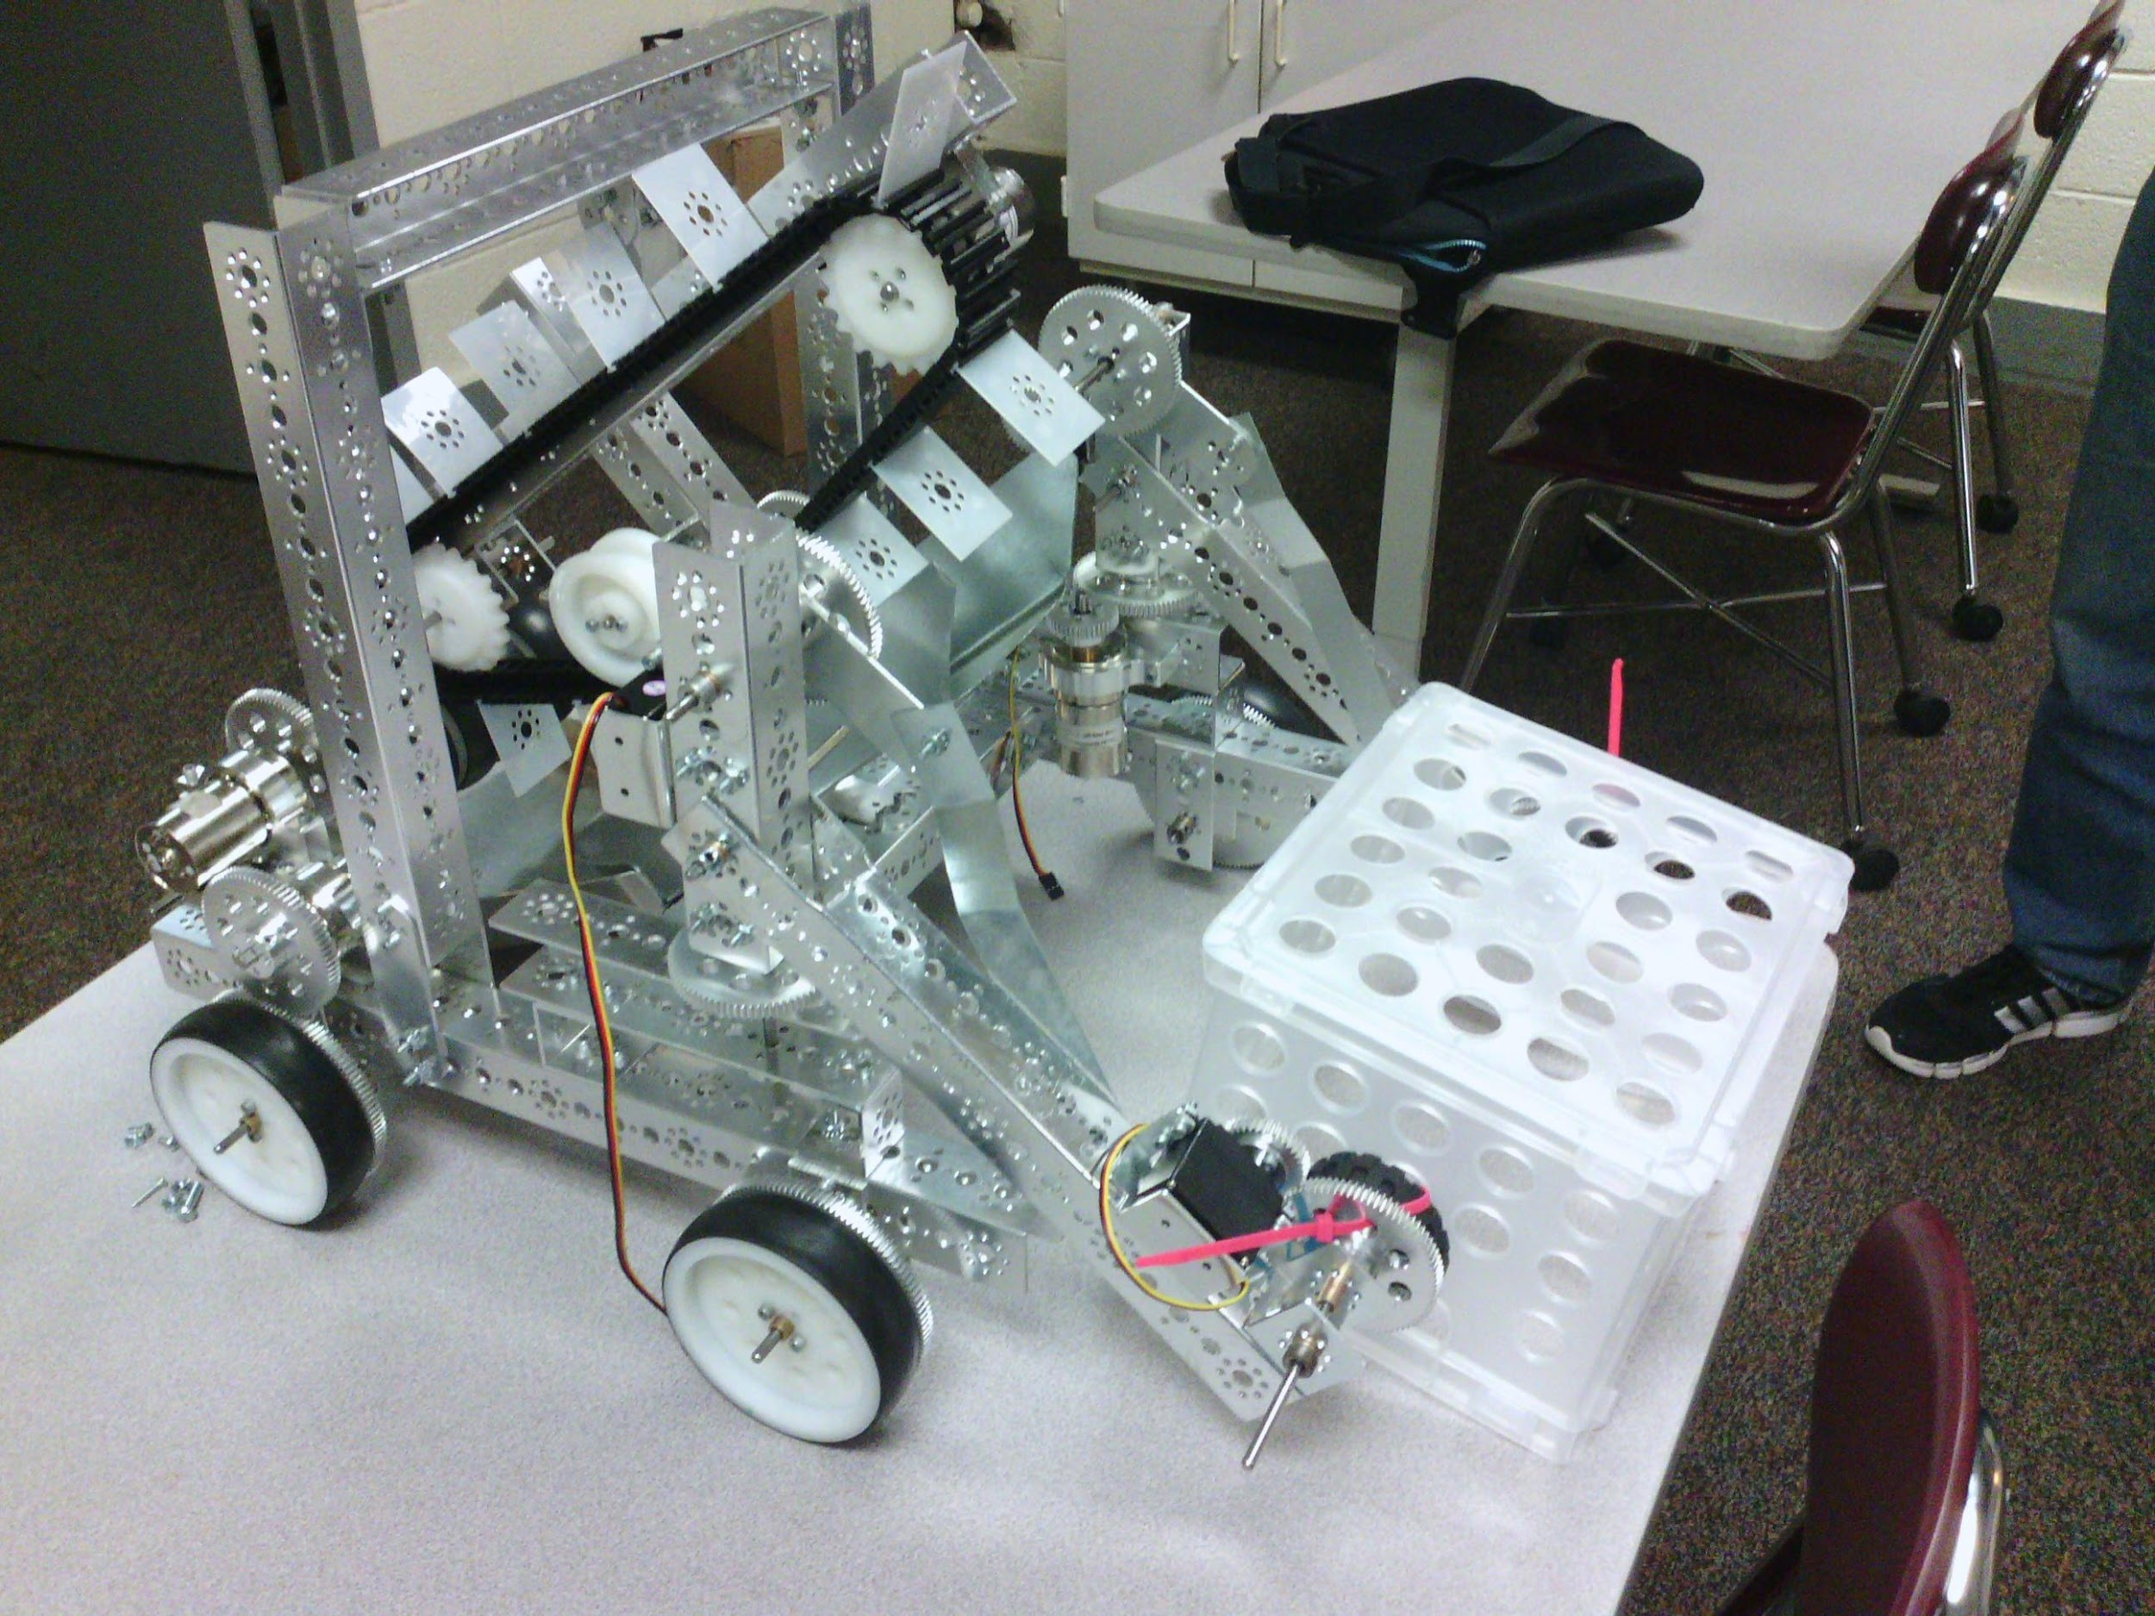
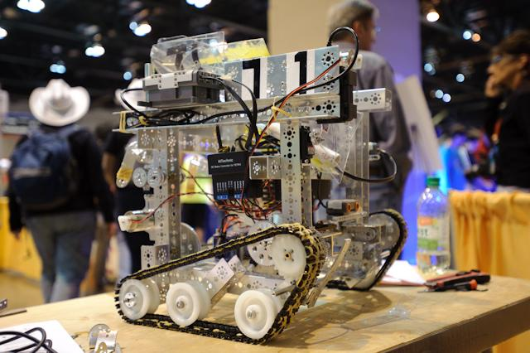
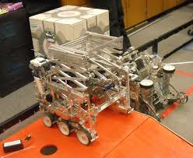
Example Robots

Slide 4
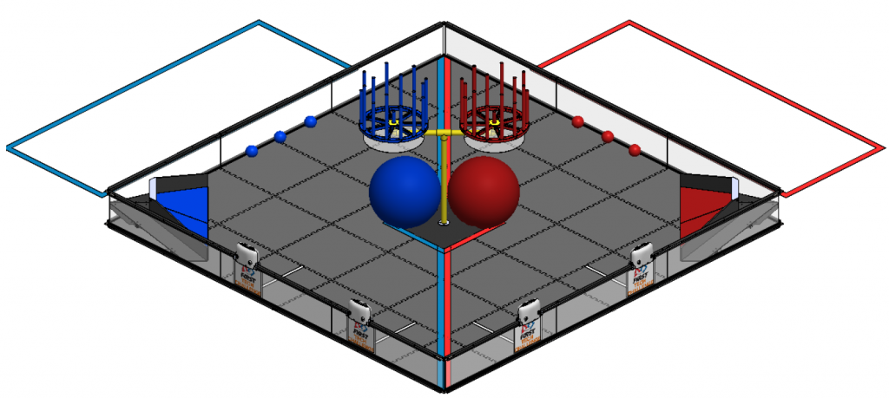
This Year’s Challenge
Animated explanation: https://www.youtube.com/watch?v=MCQ_pgSw_-8

Slide 5
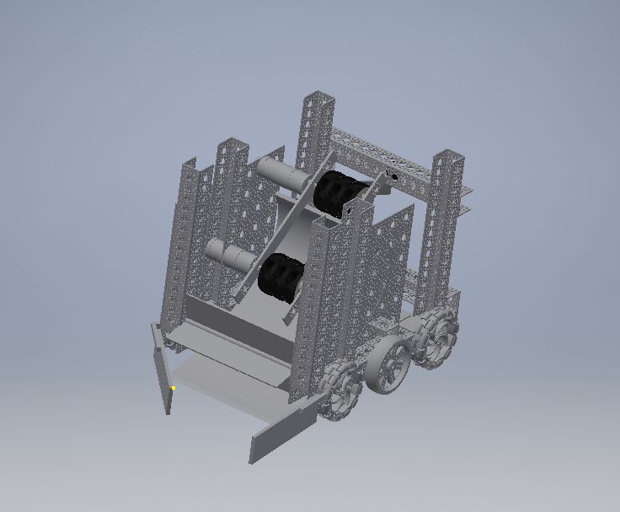
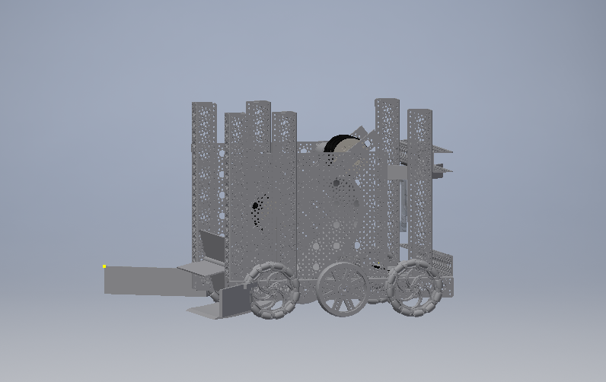
Rough 3D design of our robot
(Done in Autodesk Inventor)

Slide 6
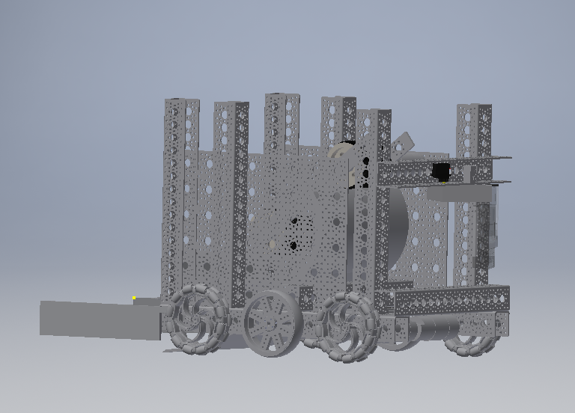
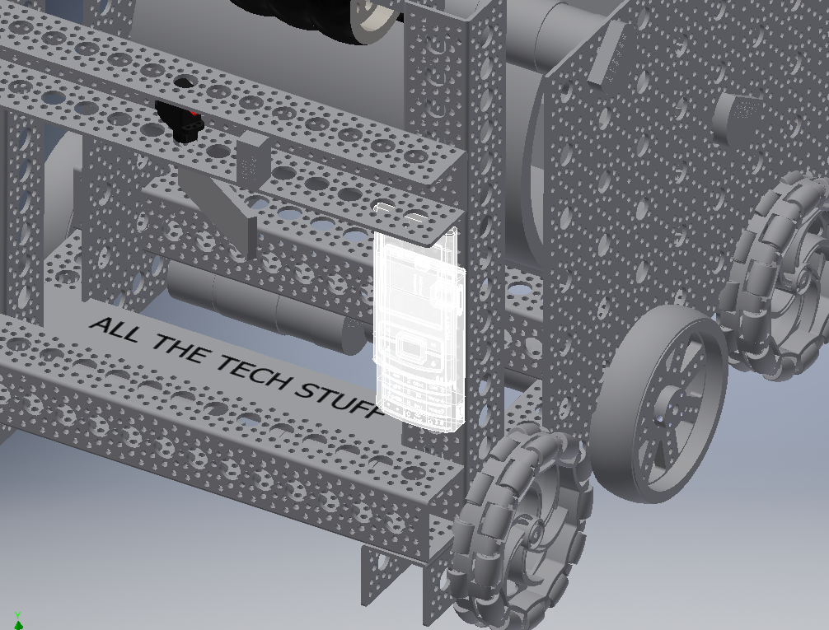
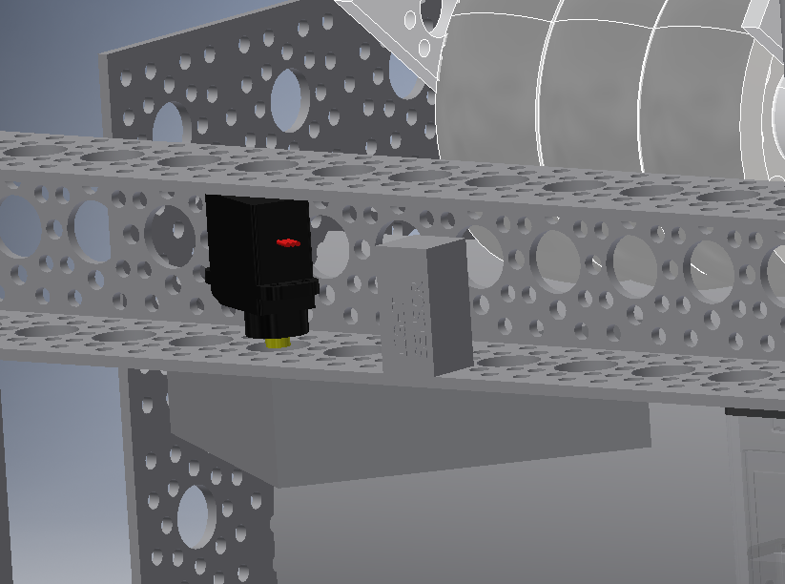
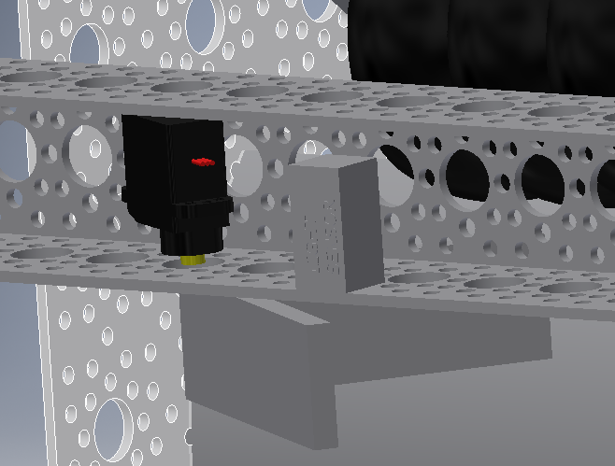

Slide 7
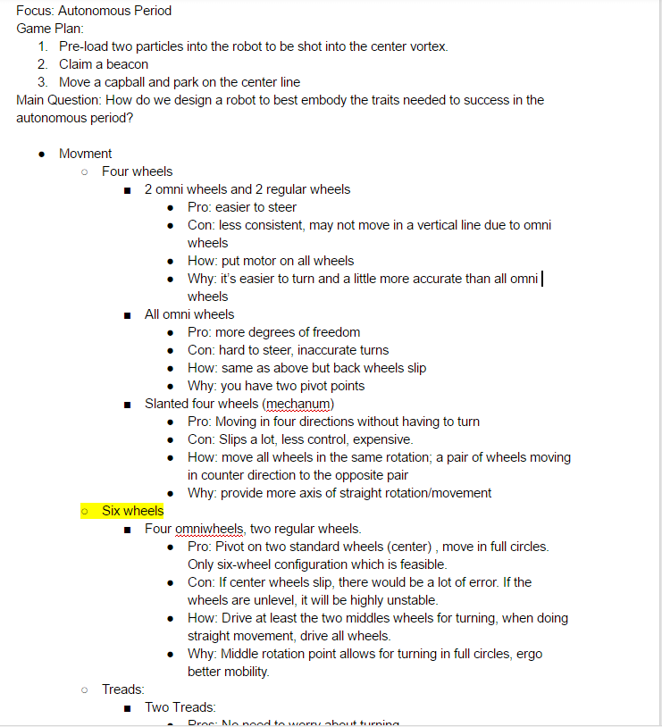
Our Modified Design Matrix

Slide 8
Objectives
Participate and place in the state tournament
Learn about robotics and have fun
Share our knowledge about robotics with others.

Slide 9
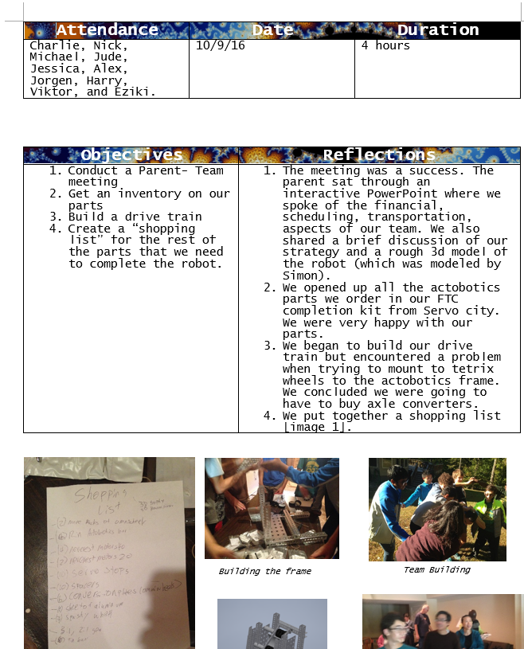
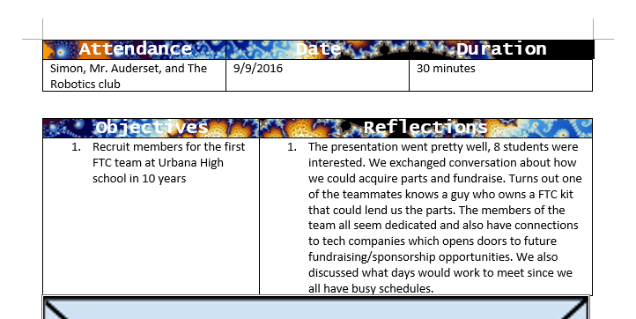
Meeting Logs
We keep detailed logs of what happens at our meetings

Slide 10
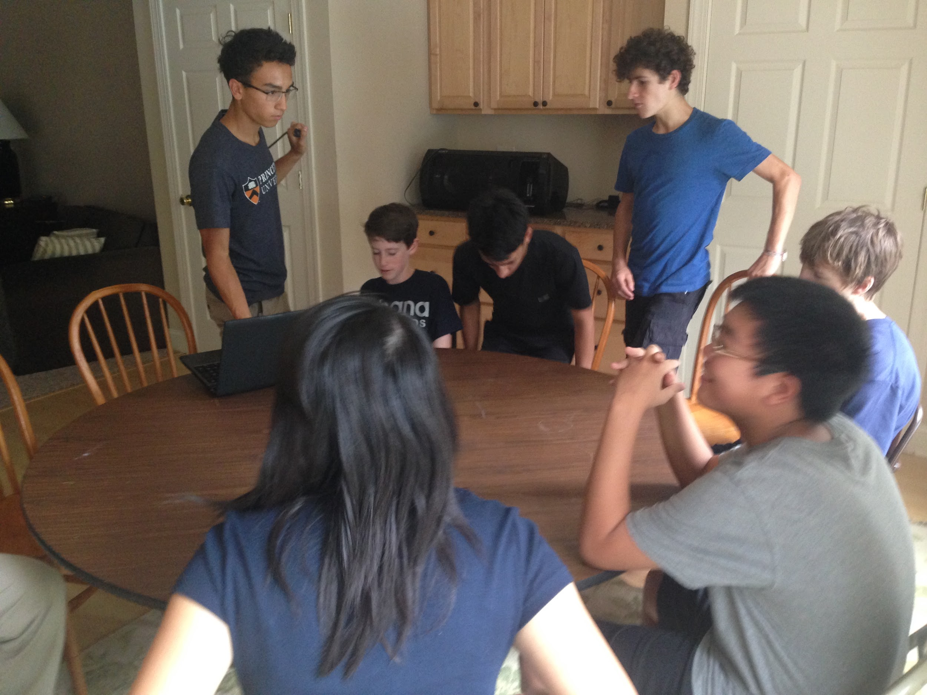
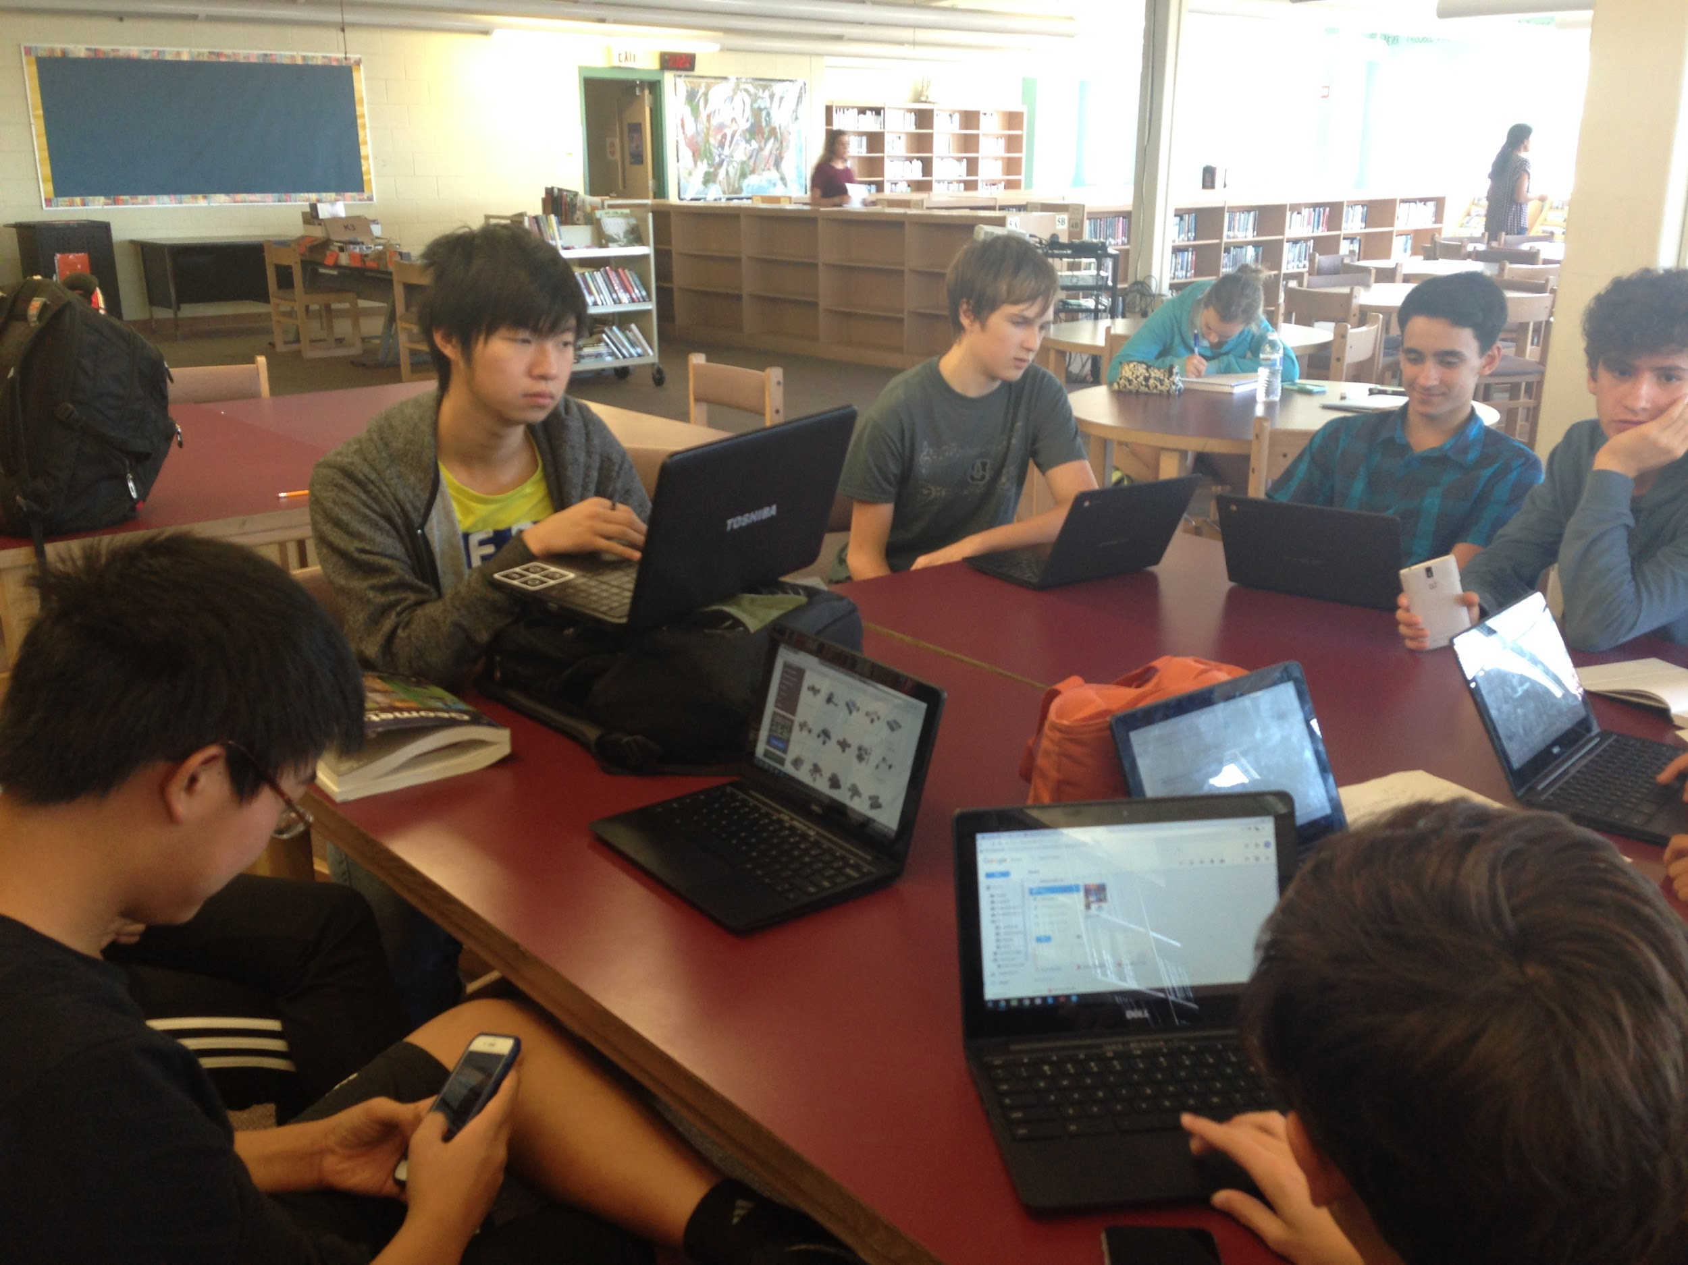
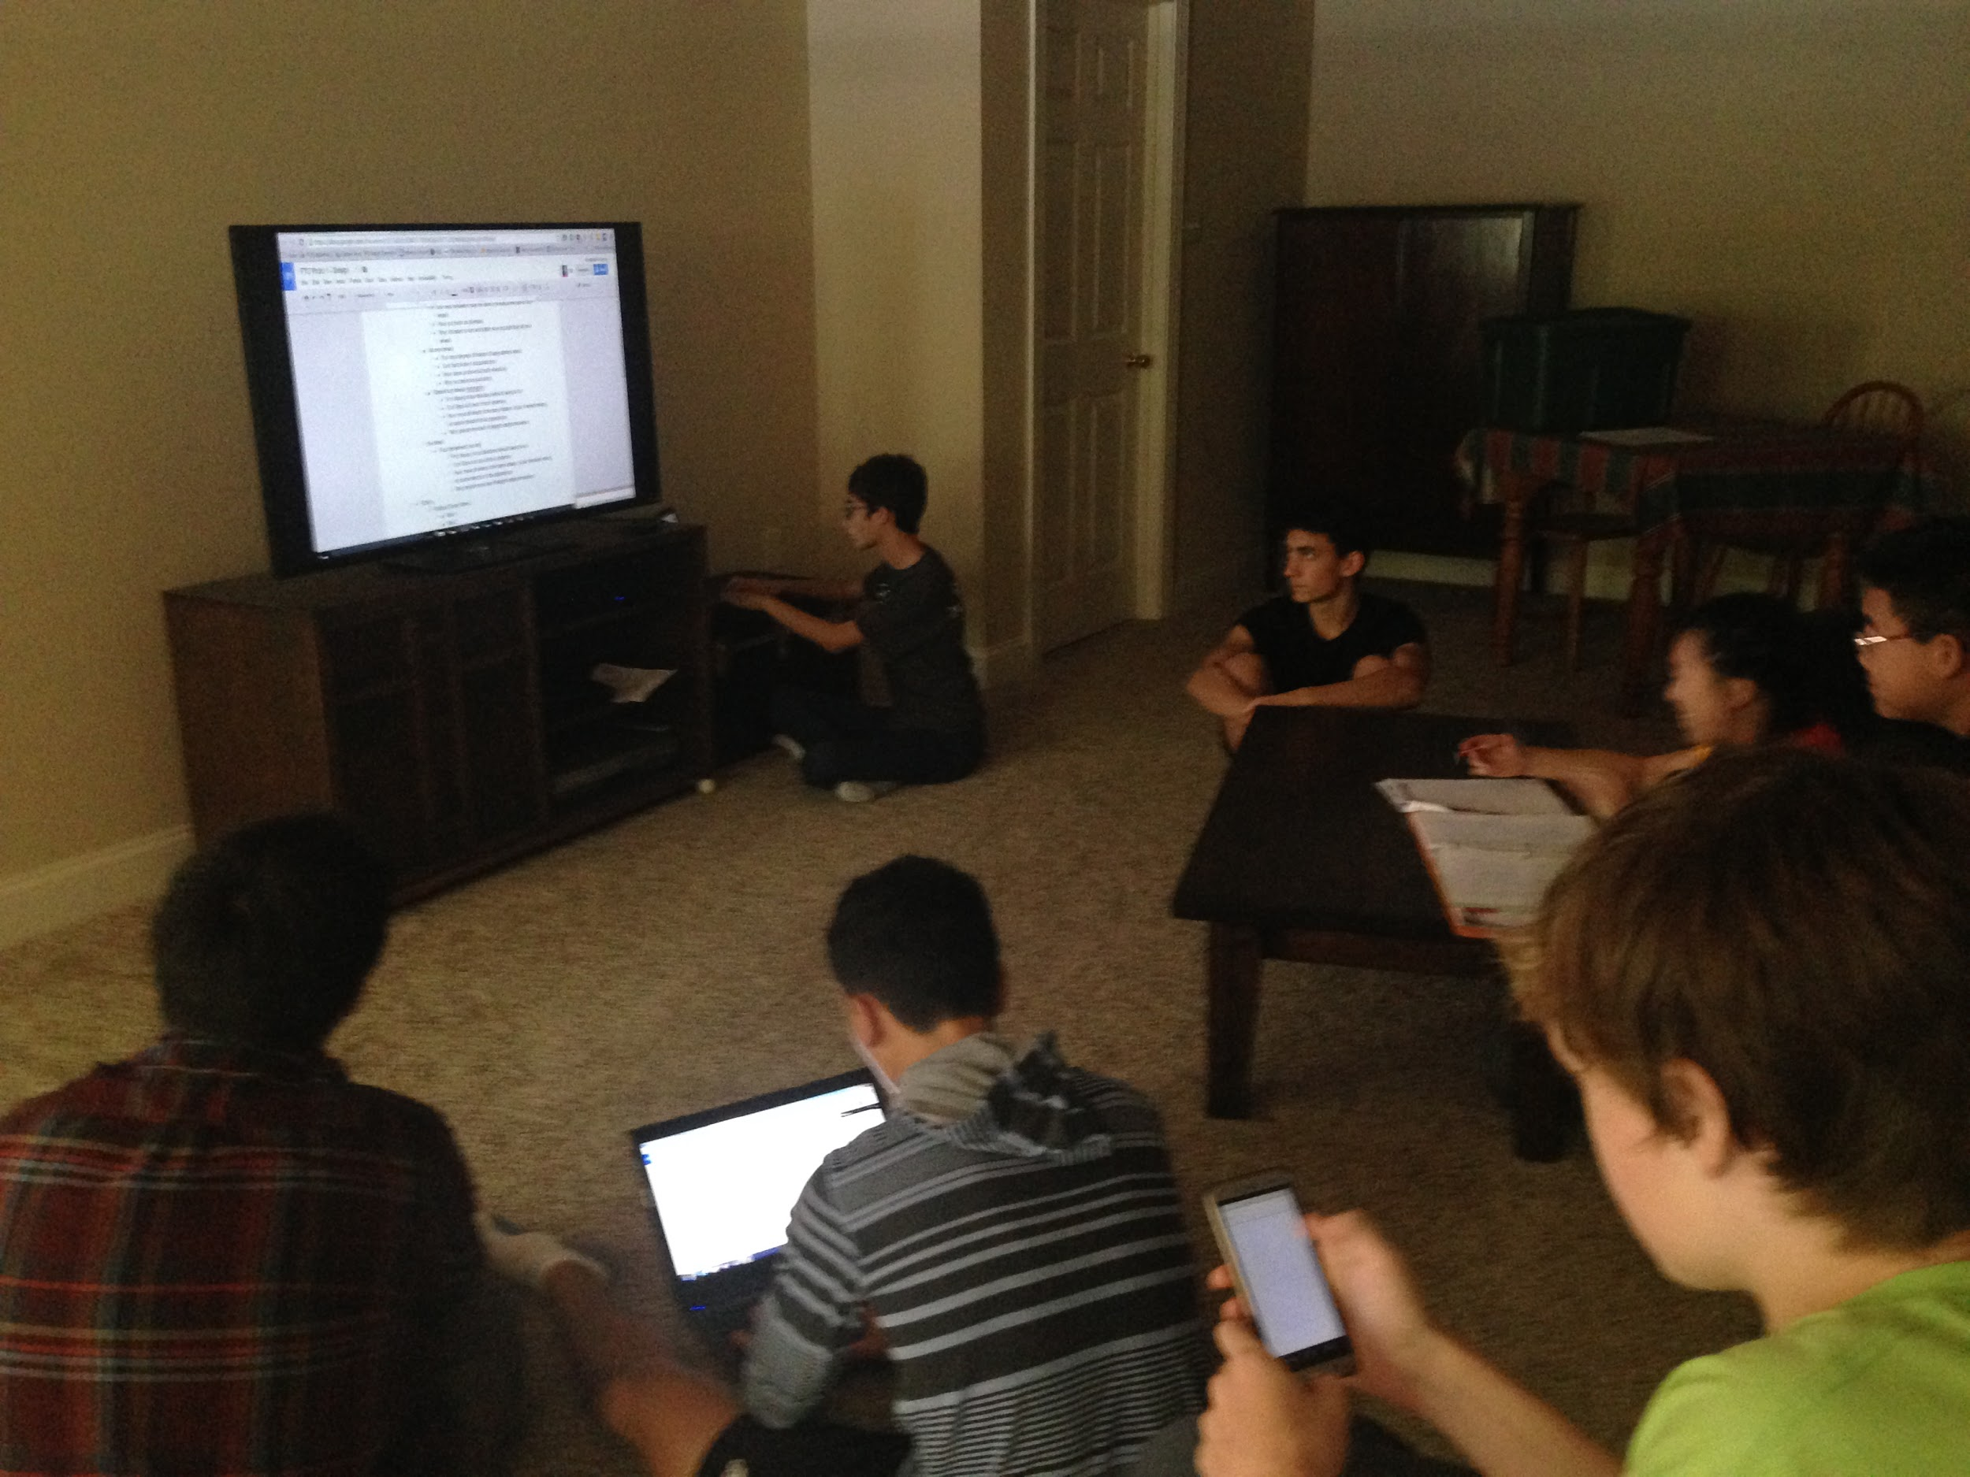
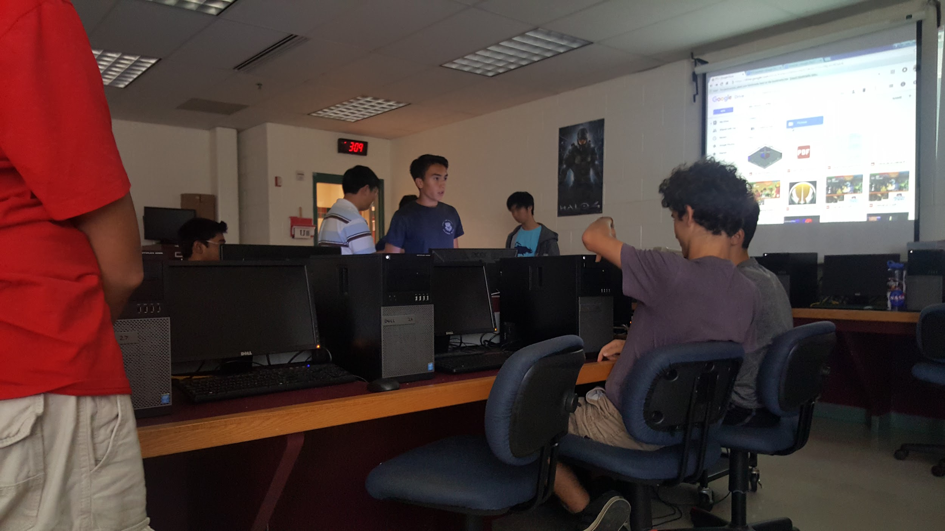
Brainstorming
Filling out our design Matrix as a team

Slide 11
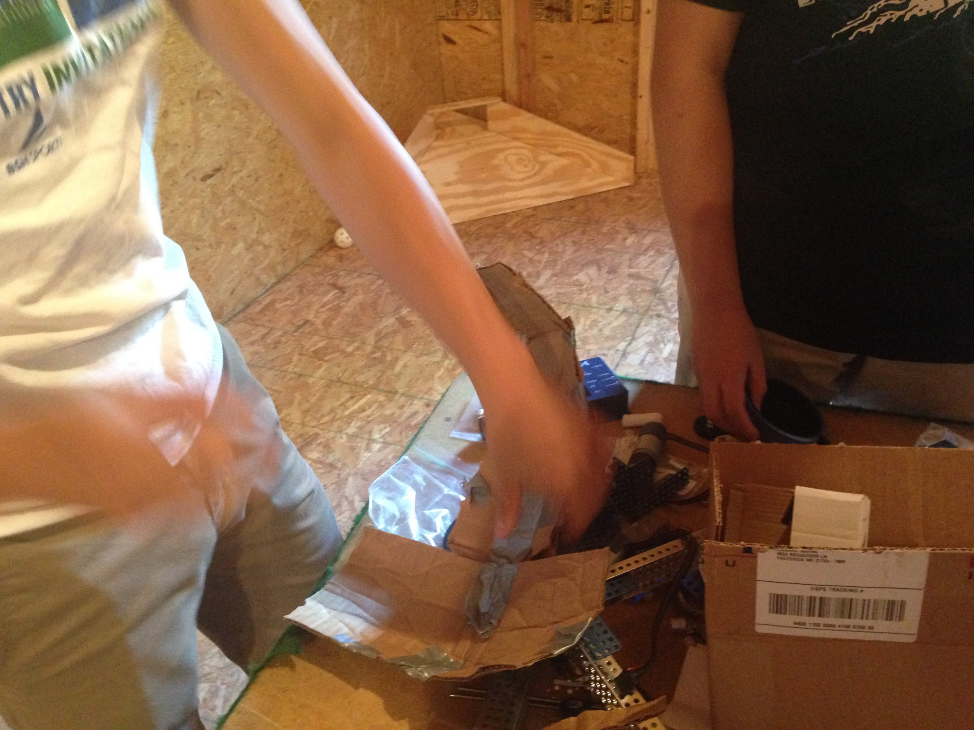
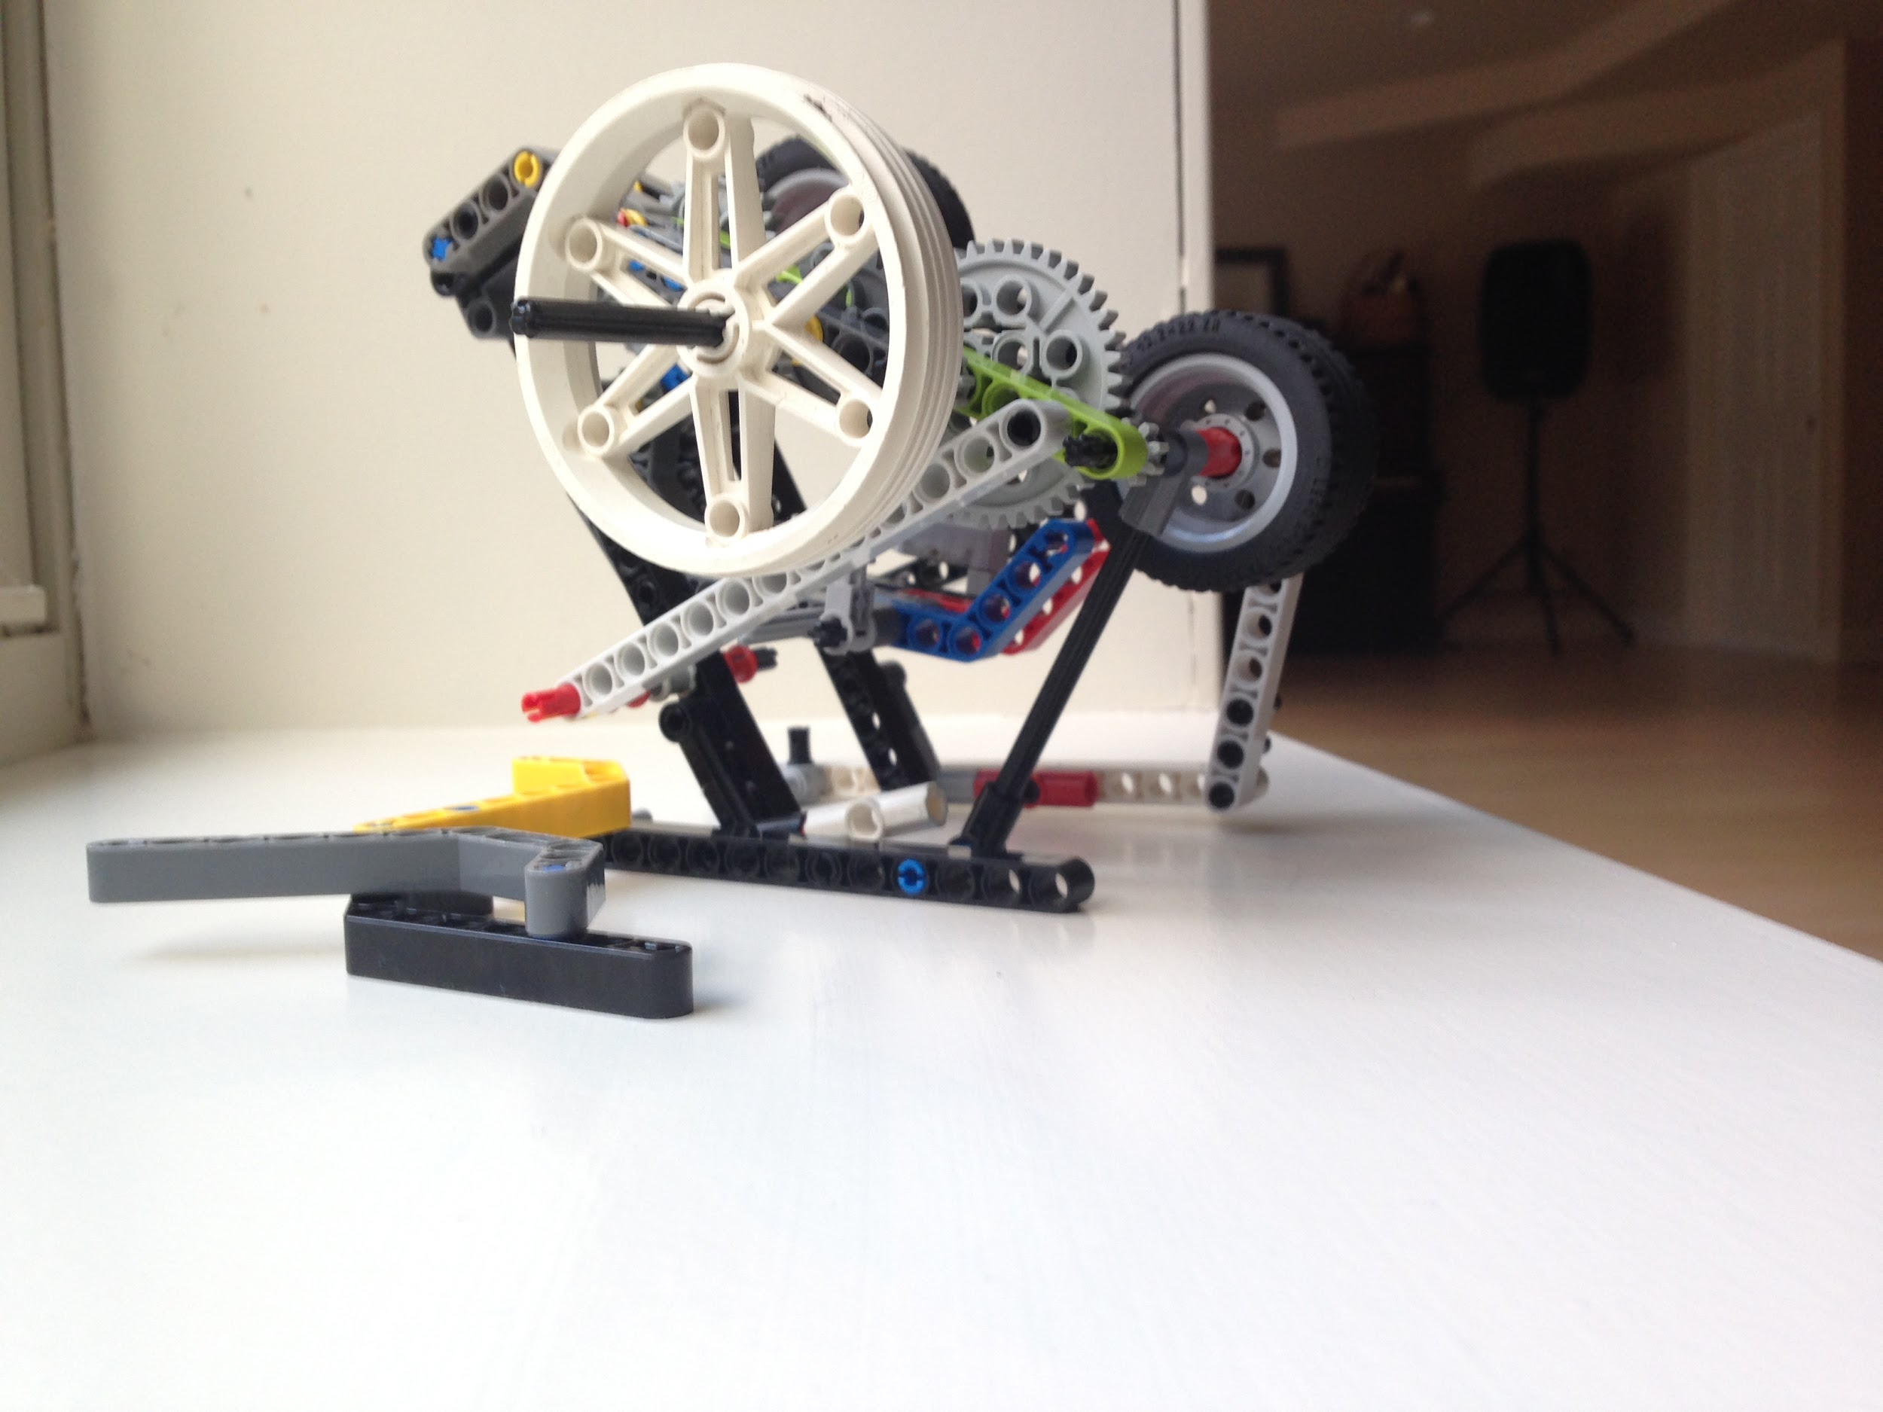
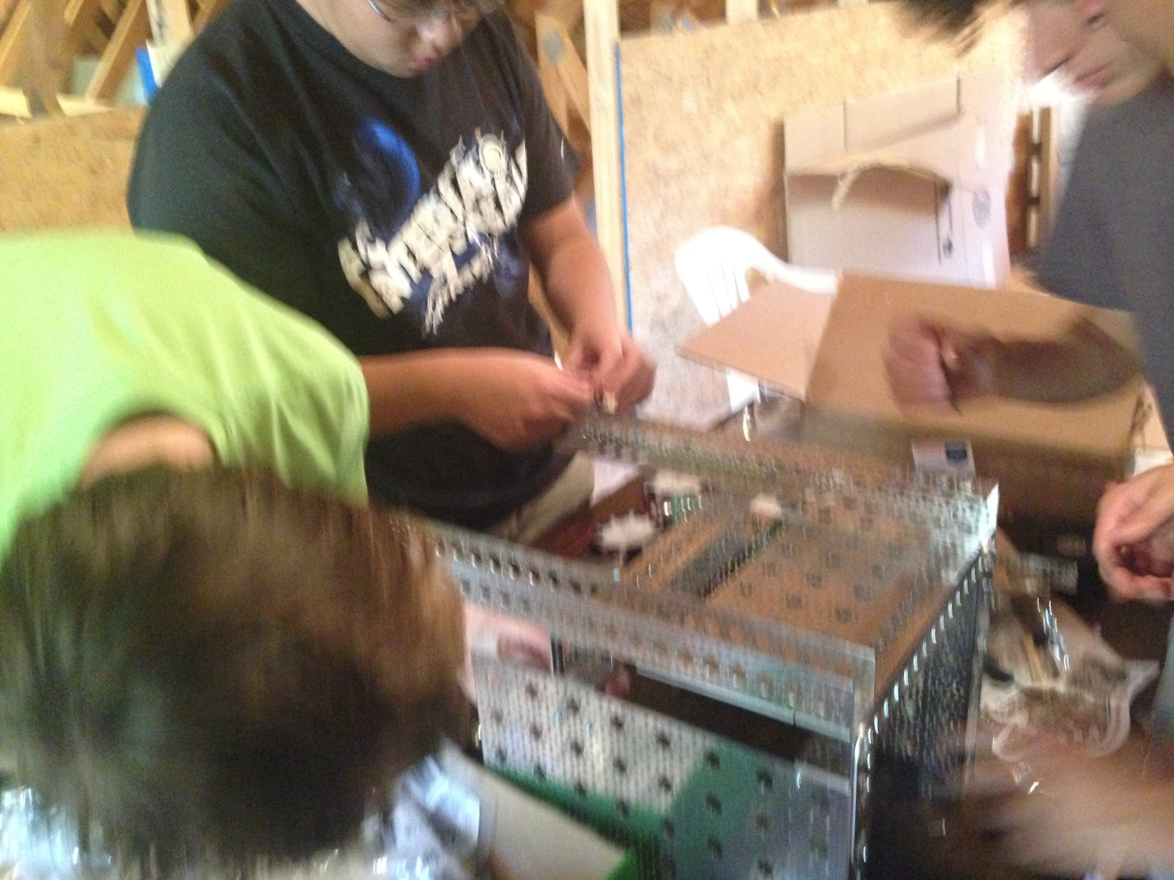
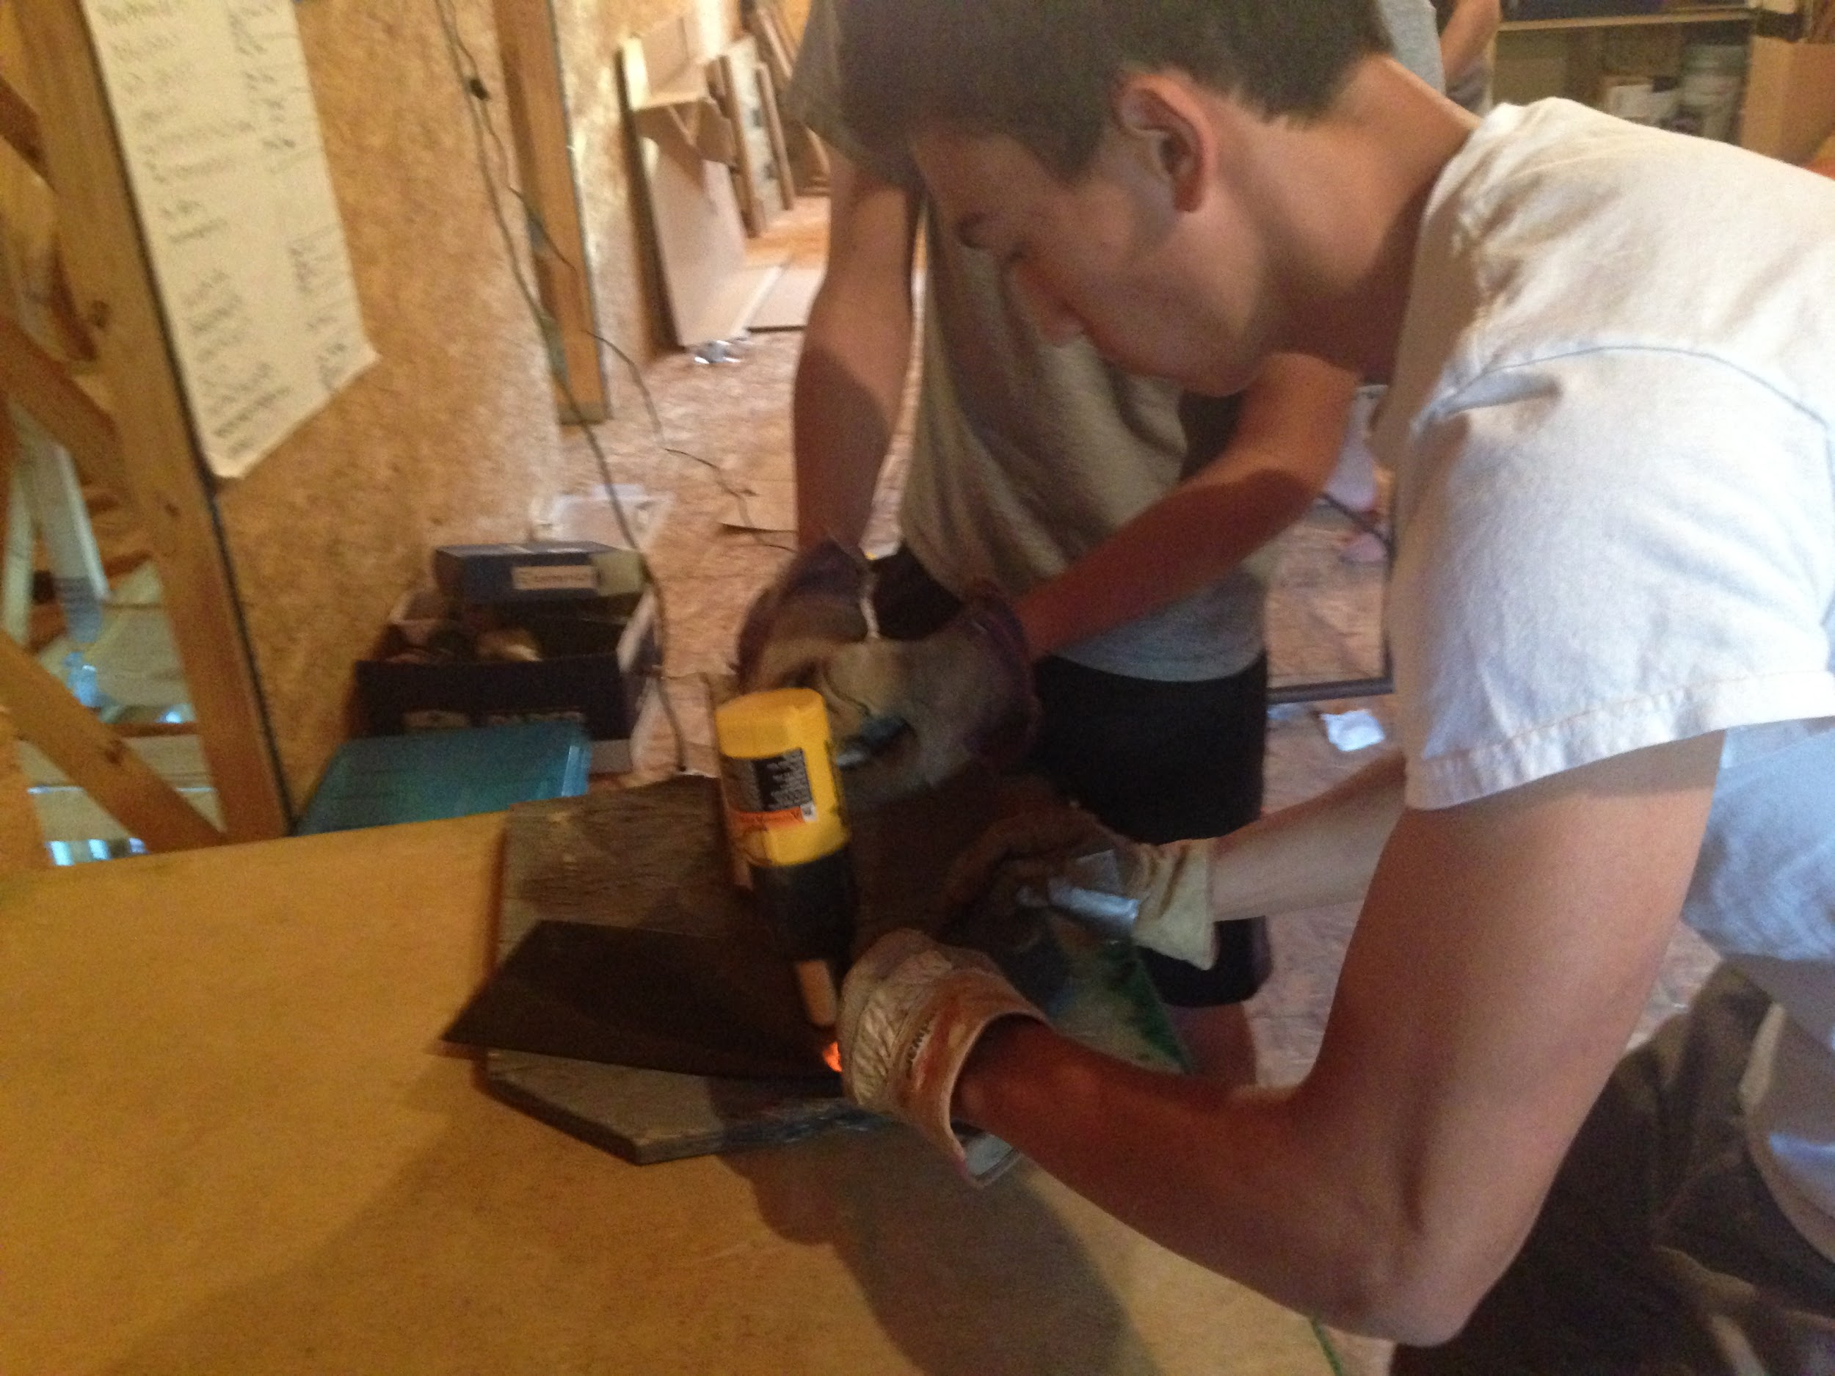
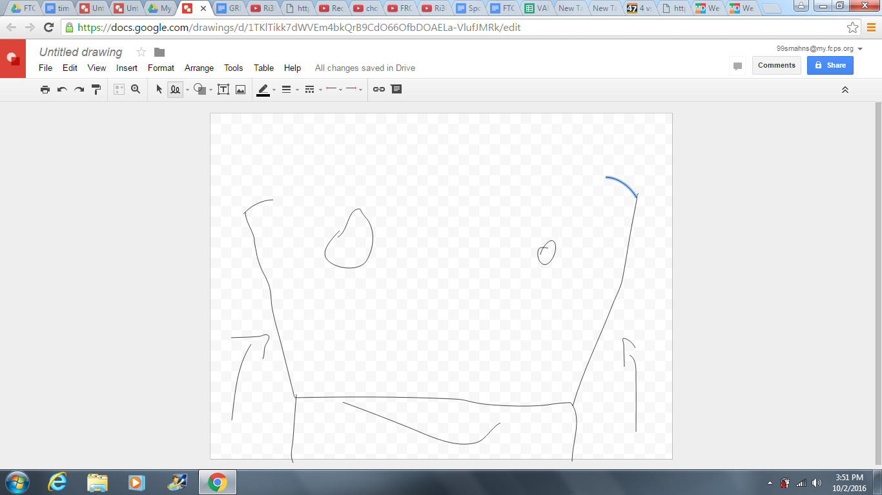
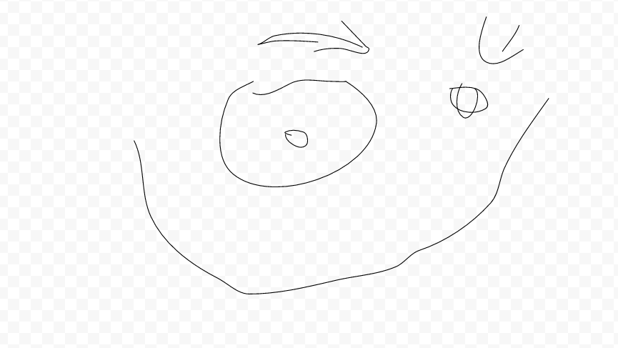
Constructing our robot
Constructing a model of the supportive ramp subassembly of the projectile launcher.
A prototype/model of our shooter system.
Constructing the robot frame and drivetrain
Some sketches for a ball grabber and a launcher (left to right)
testing out the properties of ABS plastic, a prospective material for the launcher

Slide 12
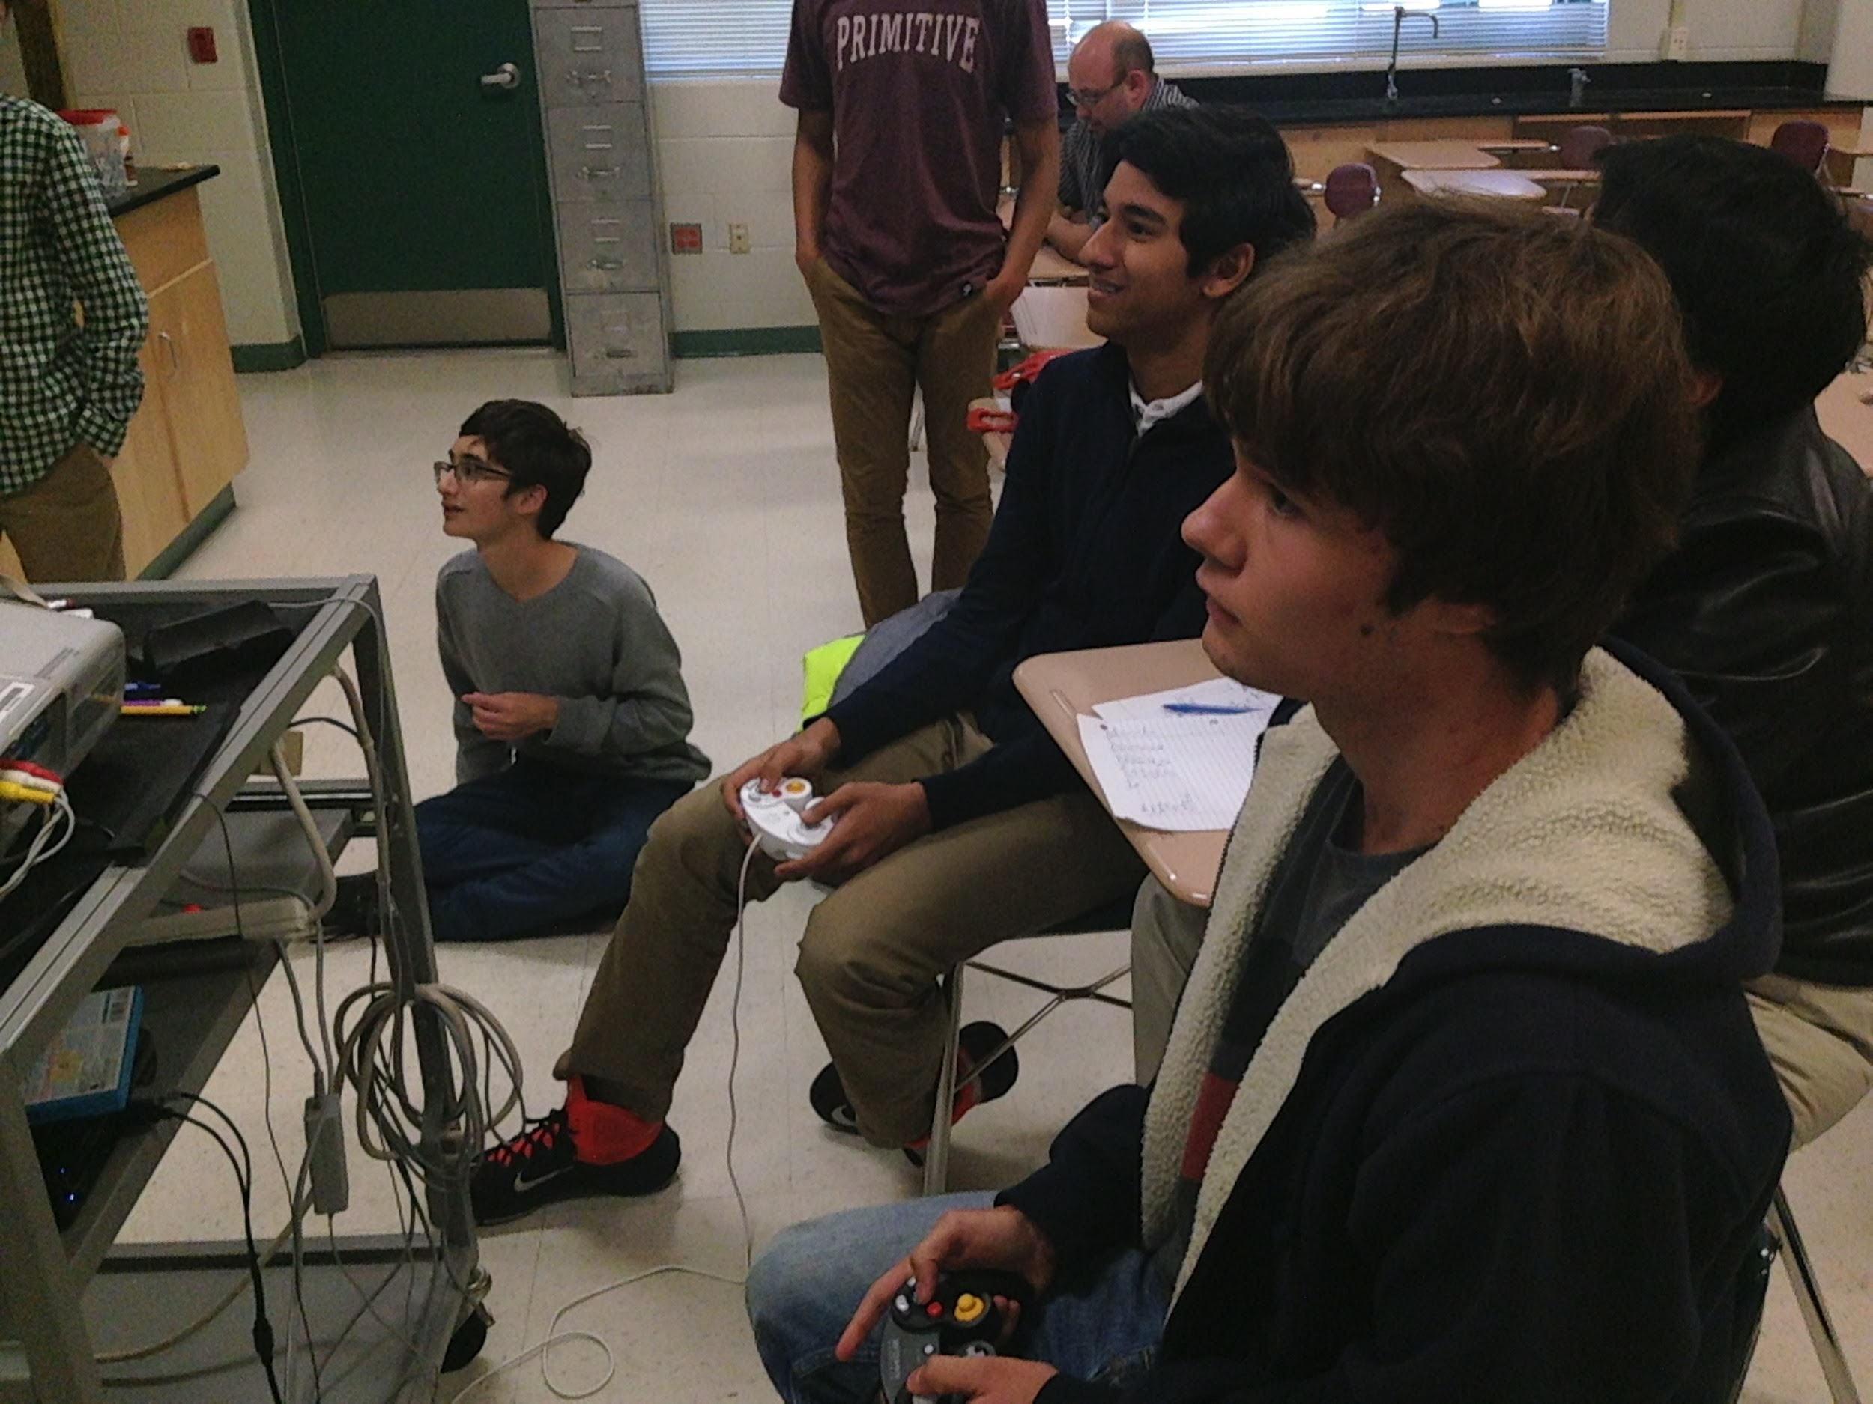
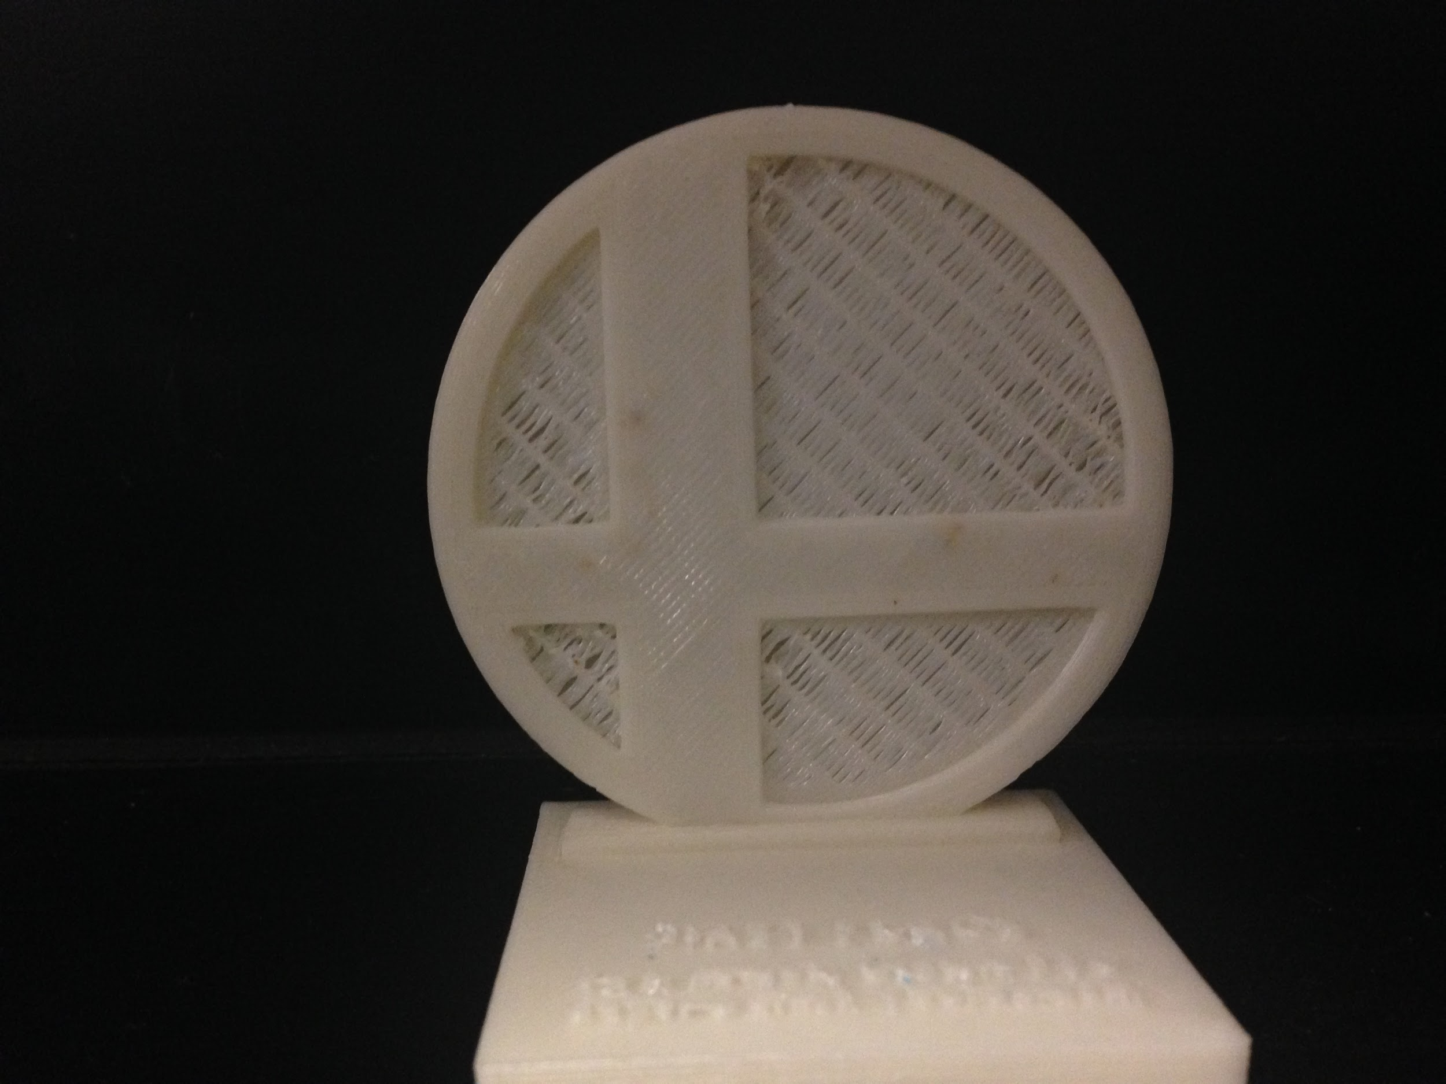
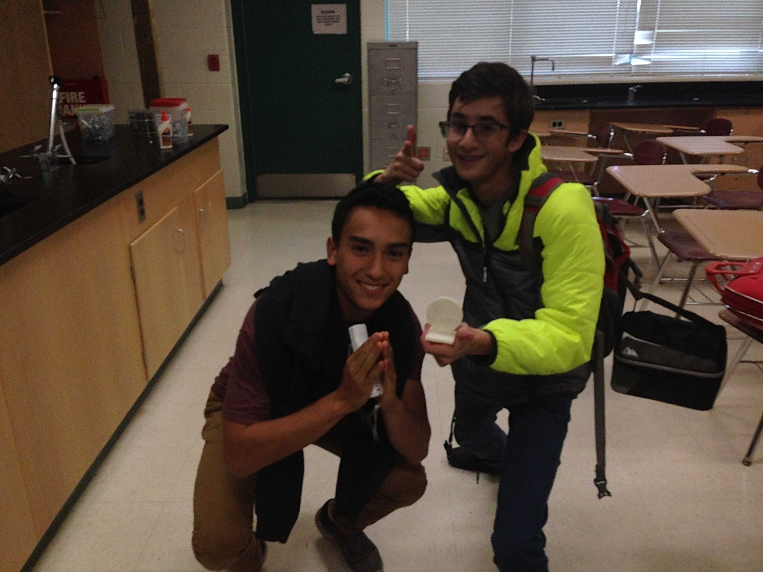
Our First Fundraiser
On Friday 14th of October, Our team held our first fundraiser. We hosted a Super Smash Bros tournament and 3d Printed a trophy (that we designed on autodesk inventor) for the winner.
The winner and his “manager”
(right to left)

Slide 13
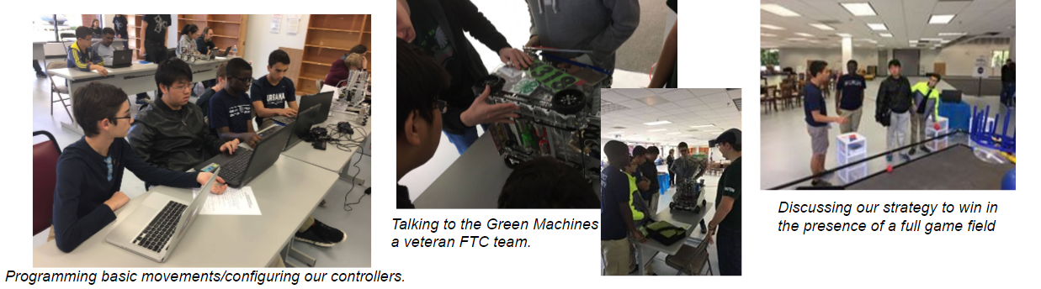
Meet the field workshop
On October 15th, our team traveled to Columbia, MD to attend a programming and robotic workshop where we got to meet other teams and talk about this year’s challenge.

Slide 14
Timeline of Events
October 15th: A Meet-the-field event/workshop on programming.
October 16th: Finish Drivetrain
October 23rd: Decide on Team uniform/Have a moving robot
October 30th: Finish Website
October 31st: First Prototype of Robot Complete
…
December 11th: DC qualifier
January 15th: Montgomery Qualifier (We are going to two qualifiers for experience and for a chance to socialize with other teams)

Slide 15
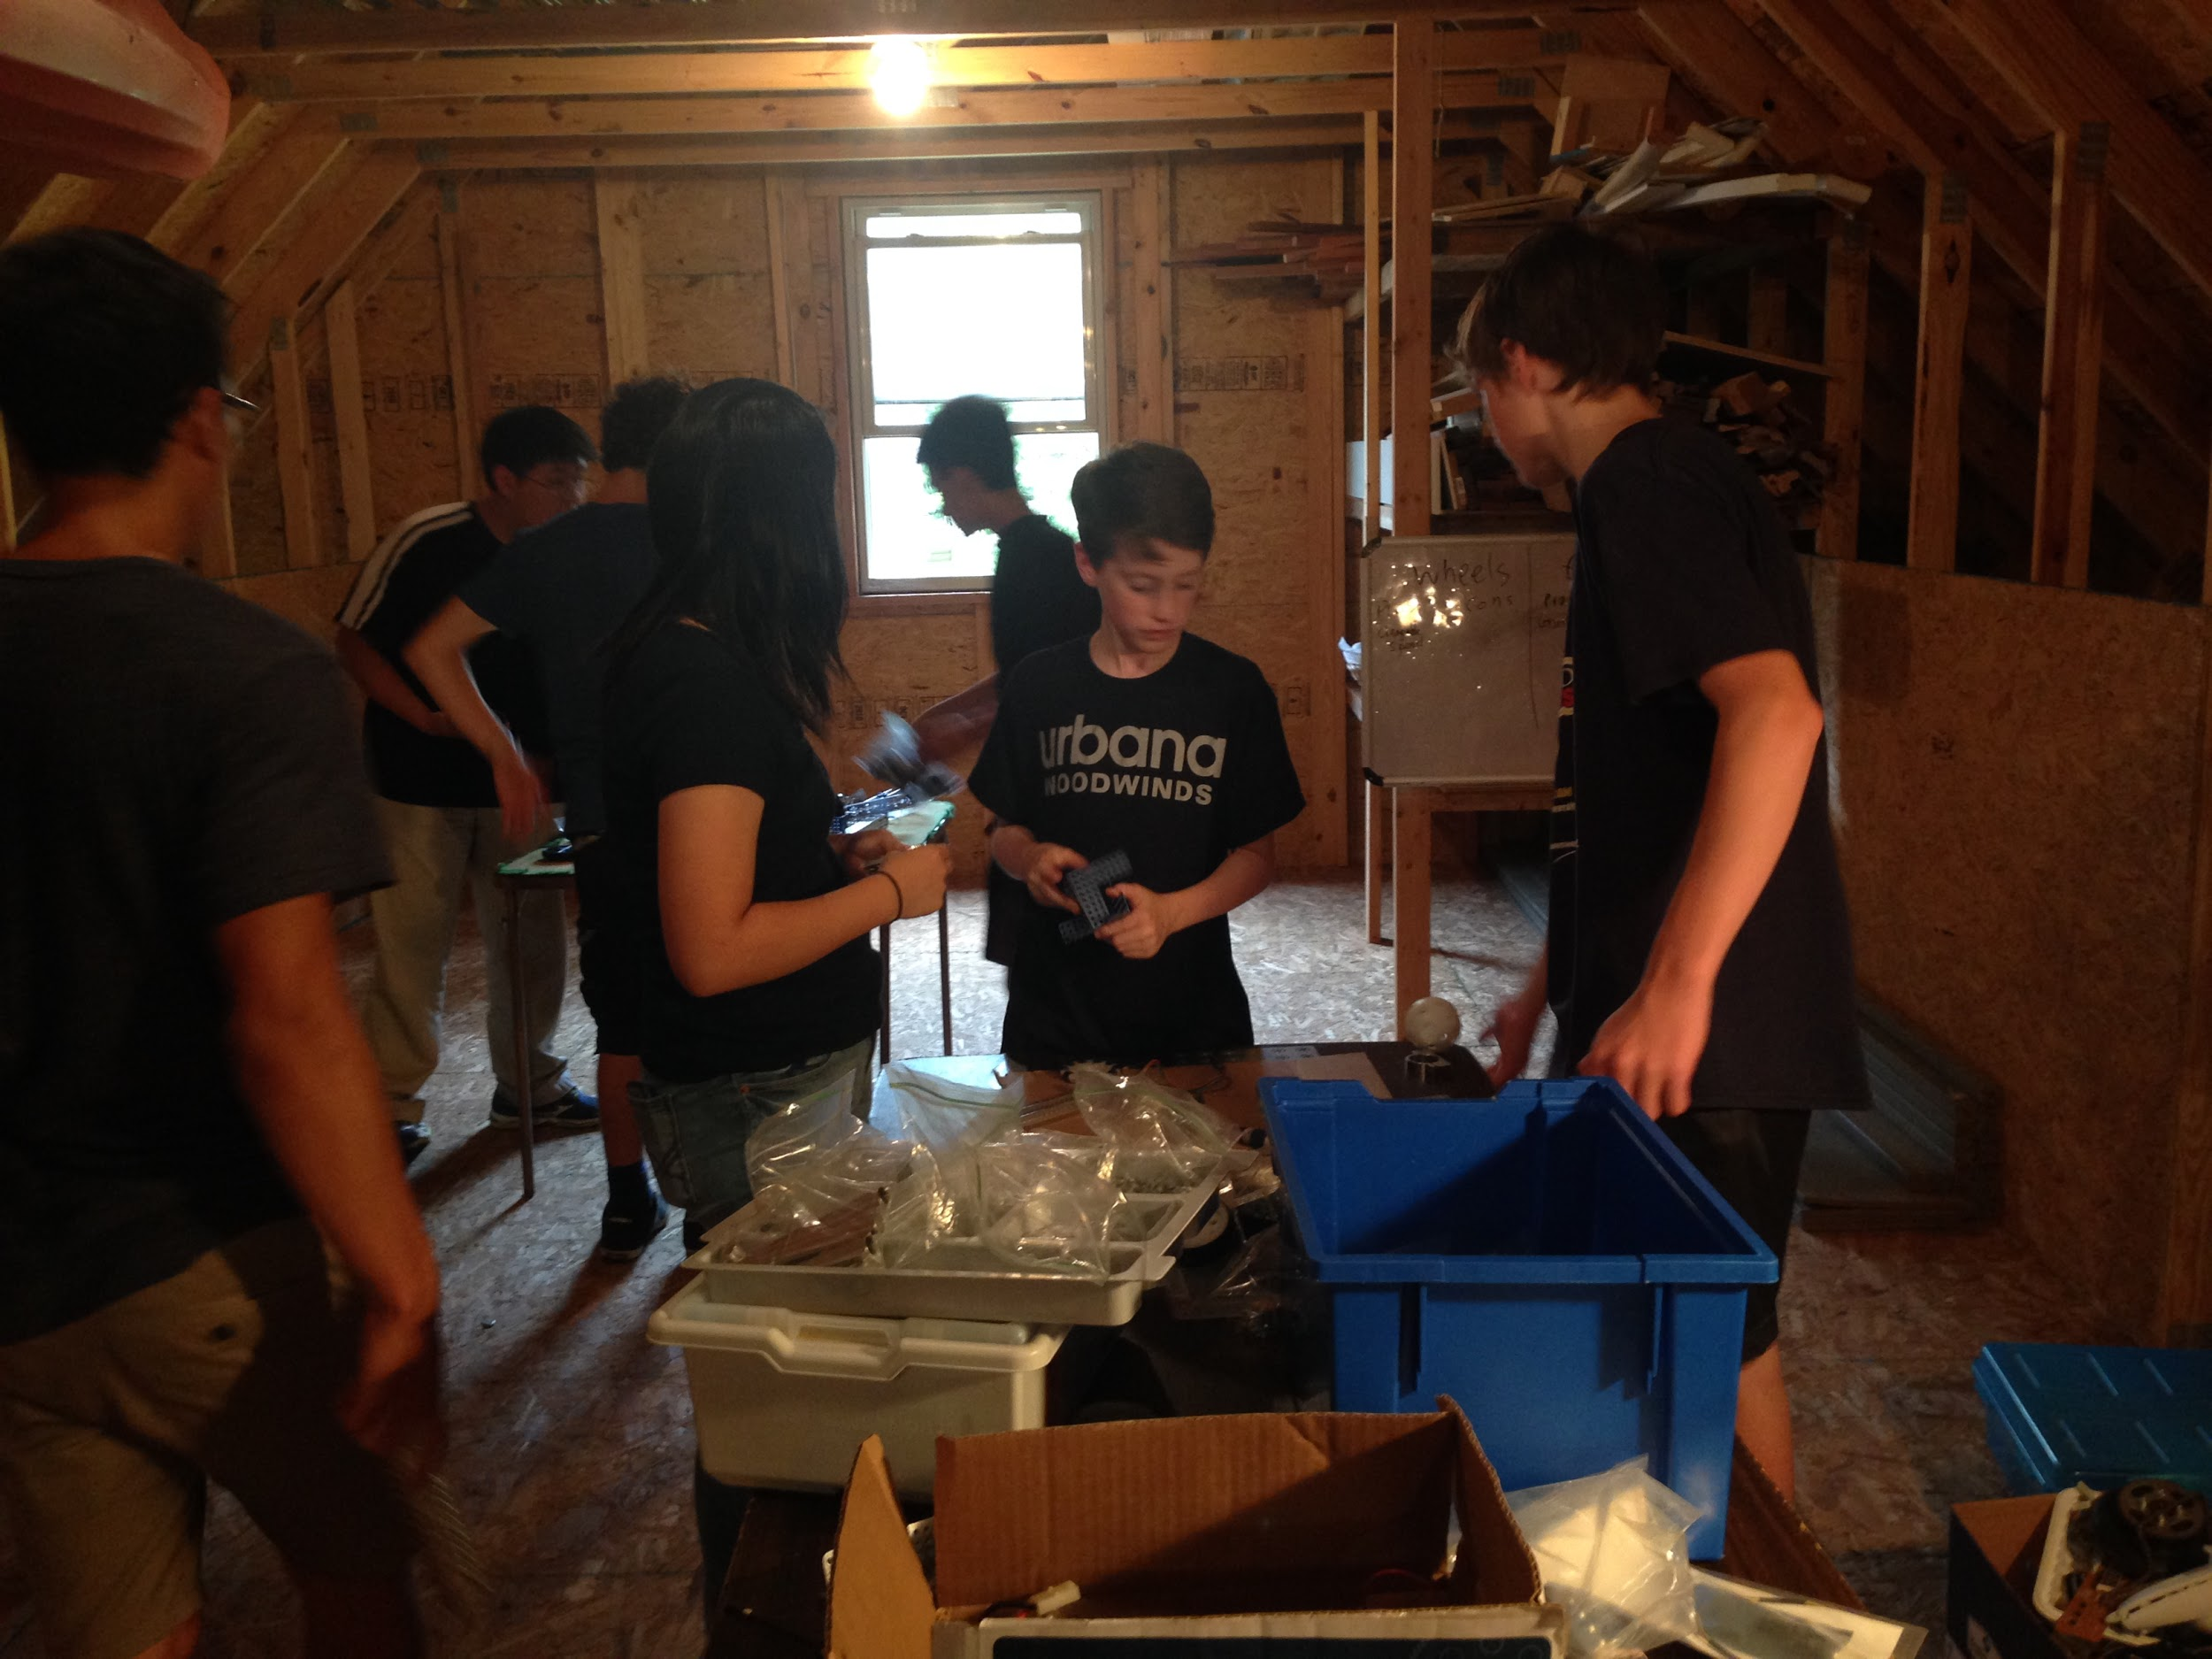


The Team
why the Mandelbots:
The Mandelbots are named after the Mandelbrot set, a series of complex numbers, that when plotted illustrates the beauty of mathematics through a mysterious pattern.

Slide 16
Social Outreach
Twitter:https://twitter.com/urbanaftc
Facebook: https://www.facebook.com/Team12063/
Instagram: https://www.instagram.com/themandelbots/
Website (under constant improvement): http://themandelbots.com/

